Slide 1
Software Engineering
(SE)

Slide 2
UNIT – IV – SYLLABUS
Coding and Testing
Coding standards and guidelines, code review, software documentation, Testing, Black Box Testing, White Box Testing, debugging, integration testing, Program Analysis Tools, system testing, performance testing, regression testing, Testing Object Oriented Programs.

Slide 3
4.1. Coding Standards and Guidelines
The objective of the coding phase is to transform the design of a system into code in a high-level language, and then to unit test this code.
It is mandatory for the programmers to follow the coding standards.
Any code that does not conform to the coding standards is rejected during code review and the code is reworked by the concerned programmer.
Coding guidelines provide some general suggestions regarding the coding style to be followed.

Slide 4
Good software development organizations usually develop their own coding standards and guidelines depending on what suits their organization best and based on the specific types of software they develop.
Representative coding standards :
Rules for limiting the use of globals:
These rules list what types of data can be declared global and what cannot, with a view to limit the data that needs to be defined with global scope.

Slide 5
(ii) Standard headers for different modules:
The header of different modules should have standard format and information for ease of understanding and maintenance.
The following is an example of header format that is being used in some companies: → Name of the module. → Date on which the module was created. → Author’s name. → Modification history. → Synopsis of the module.

Slide 6
(iii) Naming conventions for global variables, local variables, and constant identifiers:
A popular naming convention is that variables are named using mixed case lettering. Global variable names would always start with a capital letter (e.g., GlobalData) and local variable names start with small letters (e.g., localData). Constant names should be formed using capital letters only (e.g., CONSTDATA)
(iv) Conventions regarding error return values and exception handling mechanisms:
The way error conditions are reported by different functions in a program should be standard within an organisation.

Slide 7
Representative coding guidelines:
The following are some representative coding guidelines that are recommended by many software development organizations.
Do not use a coding style that is too clever or too difficult to understand:
Code should be easy to understand.
(ii) Avoid obscure side effects:
The side effects of a function call include modifications to the parameters passed by reference, modification of global variables, and I/O operations.

Slide 8
(iii) Do not use an identifier for multiple purposes:
Programmers often use the same identifier to denote several temporary entities.
(iv) Code should be well-documented:
As a rule of thumb, there should be at least one comment line on the average for every three source lines of code.
(v) Length of any function should not exceed 10 source lines:
A lengthy function is usually very difficult to understand as it probably has a large number of variables and carries out many different types of computations.
(vi) Do not use GO TO statements:
Use of GO TO statements makes a program unstructured.

Slide 9
Purpose of Having Coding Standards:
A coding standard gives a uniform appearance to the codes written by different engineers.
It improves readability, and maintainability of the code and it reduces complexity also.
It helps in code reuse and helps to detect error easily.
It promotes sound programming practices and increases efficiency of the programmers.

Slide 10
Advantages of Coding Guidelines:
Coding guidelines increase the efficiency of the software and reduces the development time.
Coding guidelines help in detecting errors in the early phases, so it helps to reduce the extra cost incurred by the software project.
If coding guidelines are maintained properly, then the software code increases readability and understandability thus it reduces the complexity of the code.
It reduces the hidden cost for developing the software.

Slide 11
4.2. CODE REVIEW
Review is a very effective technique to remove defects from source code.
Review is a very effective technique to remove defects from source code.
That is, all the syntax errors have been eliminated from the module.
Obviously, code review does not target to design syntax errors in a program, but is designed to detect logical, algorithmic, and programming errors.
Code review has been recognised as an extremely cost-effective strategy for eliminating coding errors and for producing high quality code.

Slide 12
Eliminating an error from code involves three main activities—testing, debugging, and then correcting the errors.
Normally, the following two types of reviews are carried out on the code of a module:
→ Code inspection.
→ Code walkthrough.

Slide 13
Code Inspection :
During code inspection, the code is examined for the presence of some common programming errors.
Following is a list of some classical programming errors which can be checked during code inspection:
→ Use of uninitialized variables. → Jumps into loops. → Non-terminating loops. → Incompatible assignments.

Slide 14
→ Array indices out of bounds. →Improper storage allocation and deallocation. →Mismatch between actual and formal parameter in procedure calls. →Use of incorrect logical operators or incorrect precedence among operators. →Improper modification of loop variables. →Comparison of equality of floating point values. →Dangling reference caused when the referenced memory has not been allocated.

Slide 15
(ii) Code Walkthrough :
Code walkthrough is an informal code analysis technique. In this technique, a module is taken up for review after the module has been coded, successfully compiled, and all syntax errors have been eliminated.
The main objective of code walkthrough is to discover the algorithmic and logical errors in the code

Slide 16
Some of these guidelines are following:
The team performing code walkthrough should not be either too big or too small. Ideally, it should consist of between three to seven members.
Discussions should focus on discovery of errors and avoid deliberations on how to fix the discovered errors.
In order to foster co-operation and to avoid the feeling among the engineers that they are being watched and evaluated in the code walkthrough meetings, managers should not attend the walkthrough meetings.

Slide 17
Clean Room Testing :
Clean room testing was pioneered at IBM.
This type of testing relies heavily on walkthroughs, inspection, and formal verification.
This technique reportedly produces documentation and code that is more reliable and maintainable than other development methods relying heavily on code execution-based testing.
The main problem with this approach is that testing effort is increased as walkthroughs, inspection, and verification are time consuming for detecting all simple errors. Also testing- based error detection is efficient for detecting certain errors that escape manual inspection.

Slide 18
4.3. SOFTWARE DOCUMENTATION
When a software is developed, in addition to the executable files and the source code, several kinds of documents such as users’ manual, software requirements specification (SRS) document, design document, test document, installation manual, etc., are developed as part of the software engineering process.
All these documents are considered a vital part of any good software development practice.

Slide 19
Good documents are helpful in the following ways :
→ Good documents help enhance understandability of code. As a result, the availability of good documents help to reduce the effort and time required for maintenance.
→ Documents help the users to understand and effectively use the system.
→ Good documents help to effectively tackle the manpower turnover problem. Even when an engineer leaves the organisation, and a new engineer comes in, he can build up the required knowledge easily by referring to the documents.
→ Production of good documents helps the manager to effectively track the progress of the project.

Slide 20
Different types of software documents can broadly be classified into the following:
→ Internal documentation
→ External documentation
(i) Internal documentation : Internal documentation is the code comprehension features provided in the source code itself. Internal documentation can be provided in the code in several forms.

Slide 21
The important types of internal documentation are the following:
→ Comments embedded in the source code. → Use of meaningful variable names. → Module and function headers. → Code indentation. → Code structuring (i.e., code decomposed into modules and functions). → Use of enumerated types. → Use of constant identifiers. →Use of user-defined data types.

Slide 22
(ii) External Documentation :
External documentation is provided through various types of supporting documents such as users’ manual, software requirements specification document, design document, test document, etc.
A systematic software development style ensures that all these documents are of good quality and are produced in an orderly fashion.
An important feature that is requierd of any good external documentation is consistency with the code.

Slide 23
Another important feature required for external documents is proper understandability by the category of users for whom the document is designed.
For achieving this, Gunning’s fog index is very useful.
Gunning’s fog index :
Gunning’s fog index (developed by Robert Gunning in 1952) is a metric that has been designed to measure the readability of a document.

Slide 24
The computed metric value (fog index) of a document indicates the number of years of formal education that a person should have, in order to be able to comfortably understand that document.
That is, if a certain document has a fog index of 12, any one who has completed his 12th class would not have much difficulty in understanding that document.
The Gunning’s fog index of a document D can be computed as follows:

Slide 25
4.4. TESTING
The aim of program testing is to help realise identify all defects in a program.
However, in practice, even after satisfactory completion of the testing phase, it is not possible to guarantee that a program is error free.
Basic Concepts and Terminologies :
Testing a program involves executing the program with a set of test inputs and observing if the program behaves as expected.

Slide 26
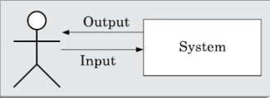
If the program fails to behave as expected, then the input data and the conditions under which it fails are noted for later debugging and error correction.

Slide 27
Terminologies :
The area of software testing has come to be associated with its own set of terminologies.
In the following, we discuss a few important terminologies that have been standardized by the IEEE Standard Glossary of Software Engineering Terminology .
→ mistake
→ error
→ failure

Slide 28
Test case :
Test case is a triplet [I , S, R], where I is the data input to the program under test, S is the state of the program at which the data is to be input, and R is the result expected to be produced by the program.
Test scenario :
Test Scenario is an abstract test case in the sense that it only identifies the aspects of the program that are to be tested without identifying the input, state, or output.
A test case can be said to be an implementation of a test scenario.

Slide 29
Test script :
Test Script is an encoding of a test case as a short program. Test scripts are developed for automated execution of the test cases.
Positive test case :
If it is designed to test whether the software correctly performs a required functionality.
Negative test case:
If it is designed to test whether the software carries out something, that is not required of the system.

Slide 30
Test suite :
Test Suite is the set of all test that have been designed by a tester to test a given program.
Testability
Testability of a requirement denotes the extent to which it is possible to determine whether an implementation of the requirement conforms to it in both functionality and performance.

Slide 31
Failure mode :
Failure mode of a software denotes an observable way in which it can fail.
Equivalent faults :
Equivalent faults denote two or more bugs that result in the system failing in the same failure mode.

Slide 32
Verification versus validation :
The objectives of both verification and validation techniques are very similar since both these techniques are designed to help remove errors in a software.
The main differences between these two techniques in the following:
Verification is the process of determining whether the output of one phase of software development conforms to that of its previous phase.
Validation is the process of determining whether a fully developed software conforms to its requirements specification.

Slide 33
The primary techniques used for verification include review, simulation, formal verification, and testing.
Validation techniques are primarily based on product testing.
Verification does not require execution of the software, whereas validation requires execution of the software.
Verification is carried out during the development process to check if the development activities are proceeding alright, whereas validation is carried out to check if the right as required by the customer has been developed.

Slide 34
Testing Activities :
Testing involves performing the following main activities:
Test suite design:
The set of test cases using which a program is to be tested is designed possibly using several test case design techniques.
Running test cases and checking the results to detect failures.
Locate error:
In this activity, the failure symptoms are analysed to locate the errors.

Slide 35
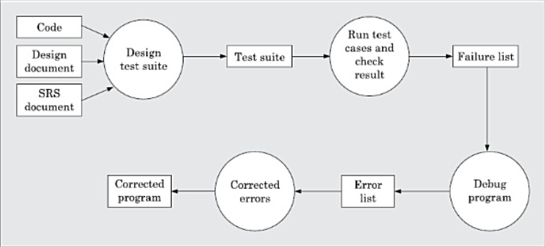
Error correction:
After the error is located during debugging, the code is appropriately changed to correct the error.

Slide 36
There are essentially two main approaches to systematically design test cases: →Black-box approach → White-box (or glass-box) approach
Testing in the Large versus Testing in the Small :
A software product is normally tested in three levels or stages:
→ Unit testing → Integration testing → System testing

Slide 37
During unit testing, the individual functions (or units) of a program are tested.
Unit testing is referred to as testing in the small, whereas integration and system testing are referred to as testing in the large.
After testing all the units individually, the units are slowly integrated and tested after each step of integration (integration testing). Finally, the fully integrated system is tested (system testing). Integration and system testing are known as testing in the large.

Slide 38
4.5. BLACK-BOX TESTING
In black-box testing, test cases are designed from an examination of the input/output values only and no knowledge of design or code is required.
The following are the two main approaches available to design black box test cases:
→ Equivalence class partitioning
→ Boundary value analysis

Slide 39
Equivalence Class Partitioning :
In the equivalence class partitioning approach, the domain of input values to the program under test is partitioned into a set of equivalence classes.
The partitioning is done such that for every input data belonging to the same equivalence class, the program behaves similarly.
Equivalence classes for a unit under test can be designed by examining the input data and output data.

Slide 40
The following are two general guidelines for designing the equivalence classes:
If the input data values to a system can be specified by a range of values, then one valid and two invalid equivalence classes need to be defined.
For example, if the equivalence class is the set of integers in the range 1 to 10 (i.e., [1,10]), then the invalid equivalence classes are [-∞,0], [11,+∞].
2. If the input data assumes values from a set of discrete members of some domain, then one equivalence class for the valid input values and another equivalence class for the invalid input values should be defined.

Slide 41
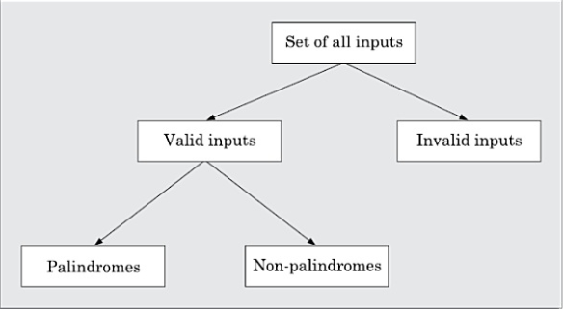

Slide 42
(ii) Boundary Value Analysis :
A type of programming error that is frequently committed by programmers is missing out on the special consideration that should be given to the values at the boundaries of different equivalence classes of inputs.
The reason behind programmers committing such errors might purely be due to psychological factors.
Programmers often fail to properly address the special processing required by the input values that lie at the boundary of the different equivalence classes.
For example, programmers may improperly use < instead of <=, or conversely <= for <, etc.

Slide 43
“Boundary value analysis-based test suite design involves designing test cases using the values at the boundaries of different equivalence classes”.
To design boundary value test cases, it is required to examine the equivalence classes to check if any of the equivalence classes contains a range of values.
For those equivalence classes that are not a range of values (i.e., consist of a discrete collection of values) no boundary value test cases can be defined.

Slide 44
For an equivalence class that is a range of values, the boundary values need to be included in the test suite.
For example, if an equivalence class contains the integers in the range 1 to 10, then the boundary value test suite is {0,1,10,11}

Slide 45
4.6. WHITE-BOX TESTING
White-box testing is an important type of unit testing.
Basic Concepts :
A white-box testing strategy can either be coverage-based or fault based.
Fault-based testing :
A fault-based testing strategy targets to detect certain types of faults. These faults that a test strategy focuses on constitutes the fault model of the strategy.

Slide 46
Coverage-based testing :
A coverage-based testing strategy attempts to execute (or cover) certain elements of a program.
Popular examples of coverage-based testing strategies are statement coverage, branch coverage, multiple condition coverage, and path coverage-based testing.
Testing criterion for coverage-based testing :
A coverage-based testing strategy typically targets to execute
(i.e., cover) certain program elements for discovering failures.

Slide 47
Stronger versus weaker testing :
A white-box testing strategy is said to be stronger than another strategy, if the stronger testing strategy covers all program elements covered by the weaker testing strategy, and the stronger strategy additionally covers at least one program element that is not covered by the weaker strategy.
When none of two testing strategies fully covers the program elements exercised by the other, then the two are called complementary testing strategies.

Slide 48
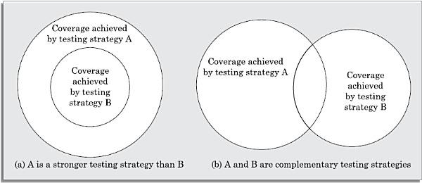
Illustration of stronger, weaker, and complementary testing strategies

Slide 49
Statement Coverage :
The statement coverage strategy aims to design test cases so as to execute every statement in a program at least once.
Branch Coverage :
A test suite satisfies branch coverage, if it makes each branch condition in the program to assume true and false values in turn.
In other words, for branch coverage each branch in the CFG representation of the program must be taken at least once, when the test suite is executed.
Branch testing is also known as edge testing, since in this testing scheme, each edge of a program’s control flow graph is traversed at least once.

Slide 50
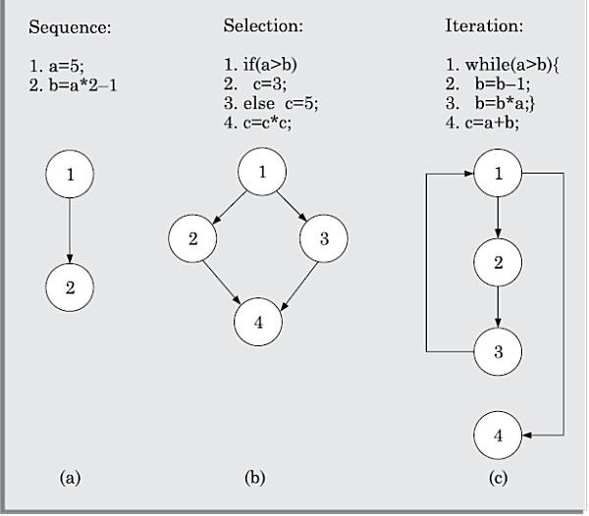
Multiple Condition Coverage :
In the multiple condition (MC) coverage-based testing, test cases are designed to make each component of a composite conditional expression to assume both true and false values.
For example, consider the composite conditional expression
((c1 .and.c2 ).or.c3).

Slide 51
Path Coverage :
A test suite achieves path coverage if it exeutes each linearly independent paths ( o r basis paths ) at least once.
A linearly independent path can be defined in terms of the control flow graph (CFG) of a program.
Therefore, to understand path coverage-based testing strategy, we need to first understand how the CFG of a program can be drawn.

Slide 52
Control flow graph (CFG) :
A control flow graph describes how the control flows through the program.
In order to draw the control flow graph of a program, we need to first number all the statements of a program.
The different numbered statements serve as nodes of the control flow graph .
There exists an edge from one node to another, if the execution of the statement representing the first node can result in the transfer of control to the other node.

Slide 53
(a) Flowchart (b) flow graph

Slide 54
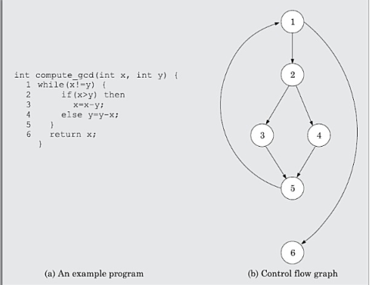

Slide 55
Path :
A path through a program is any node and edge sequence from the start node to a terminal node of the control flow graph of a program.
Please note that a program can have more than one terminal nodes when it contains multiple exit or return type of statements.
Writing test cases to cover all paths of a typical program is impractical since there can be an infinite number of paths through a program in presence of loops.

Slide 56
Linearly independent set of paths (or basis path set) :
A set of paths for a given program is called linearly independent set of paths (or the set of basis paths or simply the basis set), if each path in the set introduces at least one new edge that is not included in any other path in the set.
This is because, any path having a new node would automatically have a new edge.

Slide 57
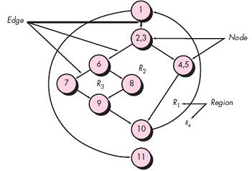
a set of independent paths for the flow graph
Path 1: 1-11
Path 2: 1-2-3-4-5-10-1-11
Path 3: 1-2-3-6-8-9-10-1-11
Path 4: 1-2-3-6-7-9-10-1-11
The path
1-2-3-4-5-10-1-2-3-6-8-9-10-1-11 is not considered to be an independent path

Slide 58
McCabe’s Cyclomatic Complexity Metric :
Cyclomatic complexity is a software metric that provides a quantitative measure of the logical complexity of a program.
Cyclomatic complexity defines the number of independent paths, it is computed in one of three ways:

Slide 59
The number of regions of the flow graph corresponds to the cyclomatic complexity.
2. Cyclomatic complexity V(G) for a flow graph G is defined as
V(G) = E – N+ 2
where E is the number of flow graph edges and N is the number of flow graph nodes.
3. Cyclomatic complexity V(G) for a flow graph G is also defined as
V(G) = P+1
where P is the number of predicate nodes contained in the flow graph G.

Slide 60
1. The flow graph has four regions.
2. V(G) = 11 edges - 9 nodes +2 = 4.
3. V(G) = 3 predicate nodes + 1 = 4.
Therefore, the cyclomatic complexity of the flow graph is 4.

Slide 61
4.7. DEBUGGING
After a failure has been detected, it is necessary to first identify the program statement(s) that are in error and are responsible for the failure, the error can then be fixed.
We have some important approaches that are available to identify the error locations.

Slide 62
Debugging Approaches :
The following are some of the approaches that are popularly adopted by the programmers for debugging:
Brute force method :
This is the most common method of debugging but is the least efficient method. In this approach, print statements are inserted throughout the program to print the intermediate values with the hope that some of the printed values will help to identify the statement in error. → Backtracking : This is also a fairly common approach. In this approach, starting from the statement at which an error symptom has been observed, the source code is traced backwards until the error is discovered.

Slide 63
--> Cause elimination method :
In this approach, once a failure is observed, the symptoms of the failure are noted.
Based on the failure symptoms, the causes which could possibly have contributed to the symptom is developed and tests are conducted to eliminate each.
A related technique of identification of the error from the error symptom is the software fault tree analysis.
→ Program slicing :
Program slicing makes use of the fact that an error in the value of a variable can be caused by the statements on which it is data dependent.

Slide 64
Debugging Guidelines :
Debugging is often carried out by programmers based on their experience.
The following are some general guidelines for effective debugging:
→ Many times debugging requires a thorough understanding of the program design. Trying to debug based on a partial understanding of the program design may require an inordinate amount of effort to be put into debugging even for simple problems.

Slide 65
→ Debugging may sometimes even require full redesign of the system. In such cases, a common mistakes that novice programmers often make is attempting not to fix the error but its symptoms.
→ One must be beware of the possibility that an error correction may introduce new errors. Therefore after every round of error-fixing, regression testing must be carried out.

Slide 66
4.8. PROGRAM ANALYSIS TOOLS
A program analysis tool usually is an automated tool that takes either the source code or the executable code of a program as input and produces reports regarding several important characteristics of the program, such as its size, complexity etc.
Program analysis tools are classified into two broad categories:
→ Static analysis tools
→ Dynamic analysis tools

Slide 67
→ Static Analysis Tools :
Static program analysis tools assess and compute various characteristics of a program without executing it.
Typically, static analysis tools analyse the source code to compute certain metrics characterising the source code (such as size, cyclomatic complexity, etc.) and also report certain analytical conclusions.
These also check the conformance of the code with the prescribed coding standards.

Slide 68
Static analysis tools often summarise the results of analysis of every function in a polar chart known as Kiviat Chart.
A Kiviat Chart typically shows the analysed values for cyclomatic complexity, number of source lines, percentage of comment lines, Halstead’s metrics, etc.
A major practical limitation of the static analysis tools lies in their inability to analyse run-time information such as dynamic memory references.

Slide 69
Dynamic Analysis Tools :
Dynamic program analysis tools can be used to evaluate several program characteristics based on an analysis of the run time behaviour of a program.
These tools usually record and analyse the actual behaviour of a program while it is being executed.
Normally the dynamic analysis results are reported in the form of a histogram or pie chart to describe the structural coverage achieved for different modules of the program.
The output of a dynamic analysis tool can be stored and printed easily to provide evidence that thorough testing has been carried out.

Slide 70
4.9. INTEGRATION TESTING
Integration testing is carried out after all (or at least some of ) the modules have been unit tested.
Successful completion of unit testing, to a large extent, ensures that the unit (or module) as a whole works satisfactorily.
In this context, the objective of integration testing is to detect the errors at the module interfaces (call parameters).
For example, it is checked that no parameter mismatch occurs when one module invokes the functionality of another module.

Slide 71
Thus, the primary objective of integration testing is to test the module interfaces, i.e., there are no errors in parameter passing, when one module invokes the functionality of another module.
An important factor that guides the integration plan is the module dependency graph.
By examining the structure chart, the integration plan can be developed.

Slide 72
Any one (or a mixture) of the following approaches can be used to develop the test plan:
Big-bang approach to integration testing → Top-down approach to integration testing → Bottom-up approach to integration testing → Mixed (also called sandwiched ) approach to integration testing

Slide 73
(i) Big-bang approach to integration testing :
Big-bang testing is the most obvious approach to integration testing. In this approach, all the modules making up a system are integrated in a single step. In simple words, all the unit tested modules of the system are simply linked together and tested.
(ii) Top-down approach to integration testing :
Top-down integration testing starts with the root module in the structure chart and one or two subordinate modules of the root module. After the top-level ‘skeleton’ has been tested, the modules that are at the immediately lower layer of the ‘skeleton’ are combined with it and tested.

Slide 74
(iii) Bottom-up approach to integration testing :
In bottom-up integration testing, first the modules for the each subsystem are integrated. Thus, the subsystems can be integrated separately and independently.
(iv) Mixed approach to integration testing :
The mixed (also called sandwiched ) integration testing follows a combination of top-down and bottom-up testing approaches.

Slide 75
4.10. SYSTEM TESTING
After all the units of a program have been integrated together and tested, system testing is taken up.
The system testing procedures are the same for both object-oriented and procedural programs, since system test cases are designed solely based on the SRS document.
There are essentially three main kinds of system testing depending on who carries out testing:

Slide 76
Alpha Testing: Alpha testing refers to the system testing carried out by the test team within the developing organization.
Beta Testing: Beta testing is the system testing performed by a select group of friendly customers.
Acceptance Testing: Acceptance testing is the system testing performed by the customer to determine whether to accept the delivery of the system.

Slide 77
Smoke Testing :
Smoke testing is carried out before initiating system testing to ensure that system testing would be meaningful, or whether many parts of the software would fail.
For smoke testing, a few test cases are designed to check whether the basic functionalities are working.
For example, for a library automation system, the smoke tests may check whether books can be created and deleted, whether member records can be created and deleted, and whether books can be loaned and returned.

Slide 78
4.11. Performance Testing
Performance testing is an important type of system testing.
Performance testing is carried out to check whether the system meets the non-functional requirements identified in the SRS document.
All performance tests can be considered as black-box tests.

Slide 79
The following are different performance testing techniques :
→ Stress testing → Volume testing
→ Configuration testing → Compatibility testing
→ Regression testing → Recovery testing
→ Maintenance testing → Documentation testing
→ Usability testing → Security testing

Slide 80
Stress testing :
Stress testing evaluates system performance when it is stressed for short periods of time. Stress tests are black-box tests which are designed to impose a range of abnormal and even illegal input conditions so as to stress the capabilities of the software.
Volume testing :
Volume testing checks whether the data structures (buffers, arrays, queues, stacks, etc.) have been designed to successfully handle extraordinary situations.
→ Configuration testing : Configuration testing is used to test system behavior in various hardware and software configurations specified in the requirements.

Slide 81
Compatibility testing :
This type of testing is required when the system interfaces with external systems (e.g., databases, servers, etc.).
Recovery testing :
Recovery testing tests the response of the system to the presence of faults, or loss of power, devices, services, data, etc.
→ Maintenance testing :
This addresses testing the diagnostic programs, and other procedures that are required to help maintenance of the system.

Slide 82
Documentation testing :
It is checked whether the required user manual, maintenance manuals, and technical manuals exist and are consistent.
Usability testing : Usability testing concerns checking the user interface to see if it meets all user requirements concerning the user interface. During usability testing, the display screens, messages, report formats, and other aspects relating to the user interface requirements are tested.
Security testing Security testing is essential for software that handle or process confidential data that is to be safe guard against failures.

Slide 83
4.12. Regression testing
Regression testing spans unit, integration, and system testing.
Regression testing is the practice of running an old test suite after each change to the system or after each bug fix to ensure that no new bug has been introduced due to the change or the bug fix.
Whenever a software is changed to either fix a bug, or enhance or remove a feature, regression testing is carried out.

Slide 84
4.13. TESTING OBJECT-ORIENTED PROGRAMS
Unit Testing of Object-oriented Programs :
For procedural programs, we had seen that procedures are the basic units of testing. That is, first all the procedures are unit tested.
Since methods in an object-oriented program are analogous to procedures in a procedural program, can we then consider the methods of object-oriented programs as the basic unit of testing.

Slide 85
Grey-Box Testing of Object-oriented Programs :
Model-based testing is important for objectoriented programs, as these test cases help detect bugs that are specific to the object-orientation constructs.
The following are some important types of grey-box testing that can be carried on based on UML models:
(i) State-model-based testing : State coverage
State transition coverage
State transition path coverage

Slide 86
(ii) Use case-based testing :
Scenario coverage
(iii) Class diagram-based testing :
Testing derived classes Association testing Aggregation testing Sequence diagram-based testing Method coverage Message path coverage

Slide 87
Integration Testing of Object-oriented Programs :
There are two main approaches to integration testing of object-oriented programs: → Thread-based → Use based
Thread-based approach:
In this approach, all classes that need to collaborate to realise the behaviour of a single use case are integrated and tested. After all the required classes for a use case are integrated and tested,

Slide 88
Another use case is taken up and other classes (if any) necessary for execution of the second use case to run are integrated and tested. This is continued till all use cases have been considered.
(ii) Use-based approach:
Use-based integration begins by testing classes that either need no service from other classes or need services from at most a few other classes.
After these classes have been integrated and tested, classes that use the services from the already integrated classes are integrated and tested. This is continued till all the classes have been integrated and tested.

Slide 89
END OF UNIT - 4

